Slide 1


Consumer Goods Ad-hoc Insights
Atliq Hardwares
Presented by Anupam Aditya

Slide 2

Problem statement :
Atliq Hardwares (imaginary company) is one of the leading computer hardware producers in India and well expanded in other countries too.
However, the management noticed that they do not get enough insights to make quick and smart data-informed decisions. They want to expand their data analytics team by adding several junior data analysts. Tony Sharma, their data analytics director wanted to hire someone who is good at both tech and soft skills. Hence, he decided to conduct a SQL challenge which will help him understand both the skills.

Slide 3

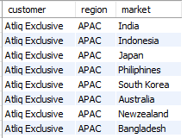
Ad-hoc-Requests
1.
Provide the list of markets in which customer "Atliq Exclusive" operates its business in the APAC region.
QUERY :
SELECT customer, region, market
FROM dim_customer
WHERE
customer = "Atliq Exclusive“
AND
region = "APAC“
;

Slide 4
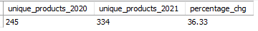
Ad-hoc-Requests
2.
What is the percentage of unique product increase in 2021 vs. 2020? The final output contains these fields unique_products_2020, unique_products_2021, percentage_chg .
QUERY :
WITH cte1 AS
(SELECT COUNT(DISTINCT product_code) AS X
FROM fact_gross_price
WHERE
fiscal_year = 2020),
cte2 AS
(SELECT COUNT(DISTINCT product_code) AS Y
FROM fact_gross_price
WHERE
fiscal_year = 2021)
SELECT X AS unique_products_2020, Y AS unique_products_2021, ROUND((Y-X)*100/X,2) AS percentage_chg
FROM cte1
JOIN
Cte2
;

Slide 5
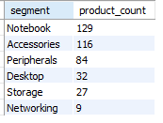
Ad-hoc-Requests
3.
Provide a report with all the unique product counts for each segment and sort them in descending order of product counts. The final output contains 2 fields segment, product_count .
QUERY :
SELECT segment, COUNT(product_code) AS product_count
FROM dim_product
GROUP BY segment
ORDER BY product_count DESC
;

Slide 6
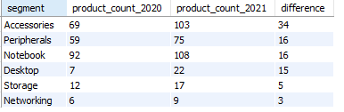
Ad-hoc-Requests
4.
Follow-up: Which segment had the most increase in unique products in 2021 vs 2020? The final output contains these fields segment, product_count_2020, product_count_2021, difference .
QUERY :
WITH cte1 AS
(SELECT segment, fiscal_year, COUNT(DM.product_code) AS product_count
FROM dim_product DM
JOIN
fact_gross_price GP ON
GP.product_code = DM.product_code
GROUP BY segment,fiscal_year
ORDER BY segment DESC)
SELECT 2020_pc.segment, 2020_pc.product_count AS product_count_2020, 2021_pc.product_count AS product_count_2021, (2021_pc.product_count-2020_pc.product_count) AS difference
FROM cte1 2020_pc
JOIN
cte1 2021_pc ON
2020_pc.segment = 2021_pc.segment
AND
2020_pc.fiscal_year = 2020AND2021_pc.fiscal_year = 2021
ORDER BY difference DESC;

Slide 7
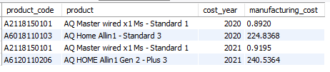
Ad-hoc-Requests
5.
Get the products that have the highest and lowest manufacturing costs. The final output should contain these fields, product_code product, manufacturing_cost .
QUERY :
WITH cte1 AS
(SELECT DM.product_code, CONCAT(product," - ",variant) AS product, cost_year, manufacturing_cost, ROW_NUMBER() OVER(PARTITION BY cost_year ORDER BY manufacturing_cost DESC ) AS HMC, ROW_NUMBER() OVER(PARTITION BY cost_year ORDER BY manufacturing_cost ASC ) AS LMC
FROM dim_product DM
JOIN fact_manufacturing_cost MC ON
MC.product_code = DM.product_code)
SELECT product_code, product, cost_year, manufacturing_cost
FROM cte1
WHERE
HMC = 1
OR
LMC = 1 ;

Slide 8
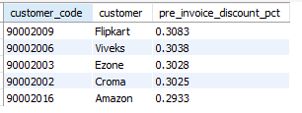
Ad-hoc-Requests
6.
Generate a report which contains the top 5 customers who received an average high pre_invoice_discount_pct for the fiscal year 2021 and in the Indian market.The final output contains these fields customer_code, customer, average_discount_percentage .
QUERY :
SELECT ID.customer_code, customer, pre_invoice_discount_pct
FROM fact_pre_invoice_deductions ID
JOIN
dim_customer DM ON
ID.customer_code = DM.customer_code
WHERE market = "India“
AND
fiscal_year = 202
AND
pre_invoice_discount_pct > (SELECT AVG(pre_invoice_discount_pct)
FROM fact_pre_invoice_deductions )
ORDER BY pre_invoice_discount_pct DESC
LIMIT 5 ;

Slide 9
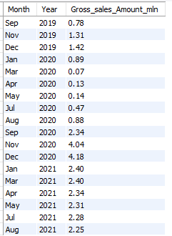
Ad-hoc-Requests
7.
Get the complete report of the Gross sales amount for the customer “Atliq Exclusive” for each month . The final report contains these columns: Month, Year, Gross sales Amount .
QUERY :
SELECT DATE_FORMAT(date, '%b') AS Month, YEAR(date) AS Year, ROUND(SUM(sold_quantity*gross_price)/1000000,2)
AS Gross_sales_Amount_mln
FROM fact_sales_monthly SM
JOIN
fact_gross_price GP ON
GP.product_code = SM.product_code
AND
GP.fiscal_year = SM.fiscal_year
WHERE
customer_code = (SELECT MAX(customer_code)
FROM dim_customer WHERE customer = "Atliq Exclusive")
GROUP BY date
ORDER BY Year ;

Slide 10
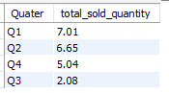
Ad-hoc-Requests
8.
In which quarter of 2020, got the maximum total_sold_quantity ? The final output contains these fields sorted by the total_sold_quantity, Quarter, total_sold_quantity .
QUERY :
SELECT CONCAT("Q",CEILING(MONTH(DATE_ADD(date, INTERVAL 4 MONTH))/3)) AS Quater, ROUND(SUM(sold_quantity)/1000000,2) AS total_sold_quantity
FROM fact_sales_monthly
WHERE
fiscal_year = 2020
GROUP BY Quarter
ORDER BY total_sold_quantity DESC ;

Slide 11
Ad-hoc-Requests
9.
Which channel helped to bring more gross sales in the fiscal year 2021 and the percentage of contribution? The final output contains these fields channel, gross_sales_mln, percentage
QUERY :
WITH cte1 AS
(SELECT channel, ROUND(SUM(sold_quantity*gross_price)/1000000,2) AS gross_sales_mln
FROM fact_sales_monthly SM
JOIN
fact_gross_price GS ON
GS.pro duct_code = SM.product_code
JOIN dim_customer DM ON
SM.customer_code = DM.customer_code
WHERE SM.fiscal_year = 2021
GROUP BY channel)
SELECT *, ROUND(gross_sales_mln*100/SUM(gross_sales_mln)OVER() ,2) AS percentage
FROM cte1
ORDER BY gross_sales_mln DESC ;

Slide 12
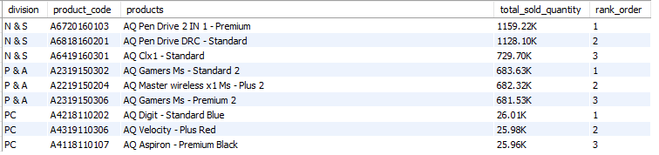
Ad-hoc-Requests
10.
Get the Top 3 products in each division that have a high total_sold_quantity in the fiscal_year 2021? The final output contains these fields division, product_code,product, total_sold_quantity, rank_order
QUERY :
WITH cte1 AS
(SELECT division, DP.product_code, CONCAT(product," - ",variant) AS products, CONCAT(ROUND(SUM(sold_quantity)/1000,2),"K") AS total_sold_quantity, ROW_NUMBER() OVER(PARTITION BY division ORDER BY SUM(sold_quantity) DESC ) AS rank_order
FROM dim_product DP
JOIN
fact_sales_monthly SM ON
SM.product_code = DP.product_code
GROUP BY DP.product_code, division, products )
SELECT *FROM cte1WHERE rank_order < 4

